Slide 1
Rapid Changes to Earth’s Surface
Wind, water and ice tend to take a while to change Earth’s surface, but there are faster ways to change it naturally.

Slide 2
How can we change Earth’s surface quickly?
Discuss with a partner things that can happen naturally that can change the way the Earth’s surface looks.

Slide 3
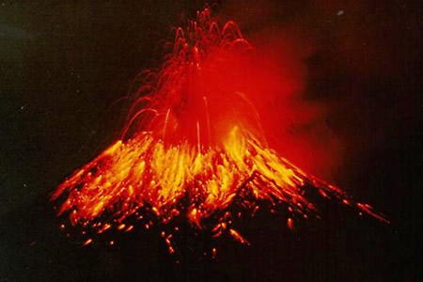
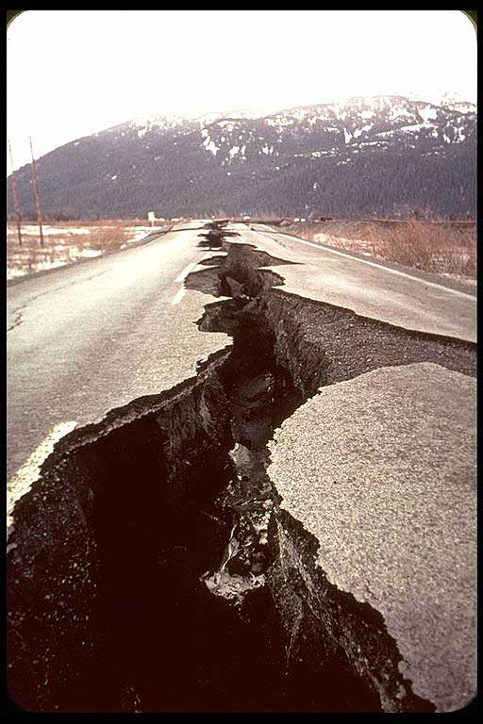
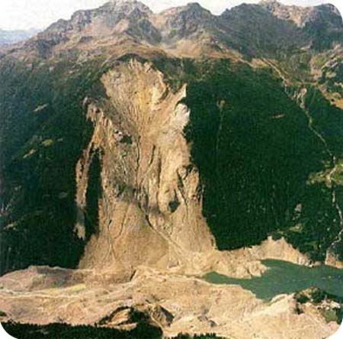
Some Processes that Change the Earth
Volcano
Earthquake
Landslide

Slide 4
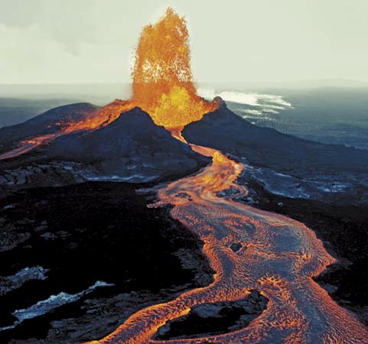
Volcanoes
Volcanic activity is one of the many ways that can change the Earth’s surface.
A volcano is a landform (usually a mountain) where molten rock erupts through the surface of the planet.
In simple terms a volcano is a mountain that opens downward to a pool of molten rock (magma) below the surface of the earth.
It is a hole in the Earth from which molten rock and gas erupt.

Slide 5
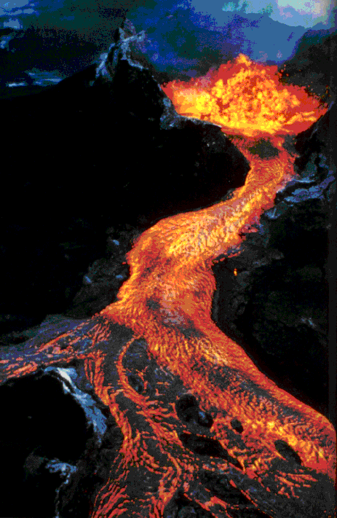
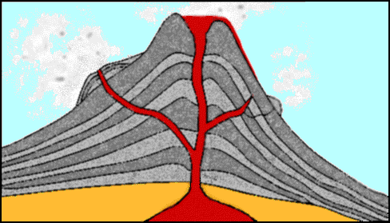
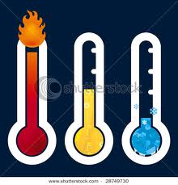
Lava is liquid rock (magma) that flows out of a volcano.
Magma is liquid rock inside a volcano.
Magma
Lava
Fresh lava ranges from 1,300° to 2,200° F (700° to 1,200° C) in temperature and glows red hot to white hot as it flows.

Slide 6
How volcanoes are formed
About Volcanoes
Our earth is hot inside and hot rock, called magma, is deep underground.
The magma in the earth builds up great pressure, and starts pushing upward.
The pressure pushes the magma through a weak spot in the ground.
It may push up the ground, forming a mountain. If it breaks through the top of the ground or the mountain it has created, a volcano is formed. The hot magma might spurt out the top of the volcano, like a fountain.
Or, it might bubble very slowly out from a crack in the ground. That crack is called a "fissure." When magma comes out of the volcano or fissure, it is then called "lava."
Sometimes, only smoke, gases and ashes come out of the volcano.

Slide 7
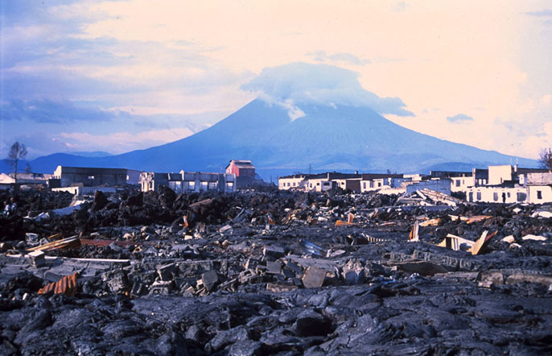
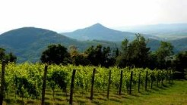
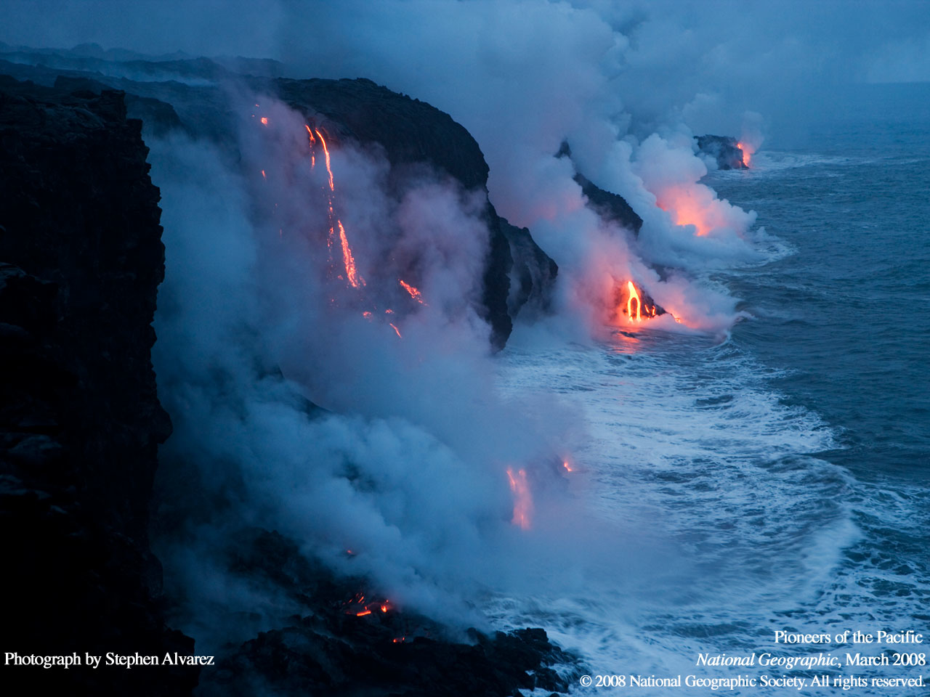
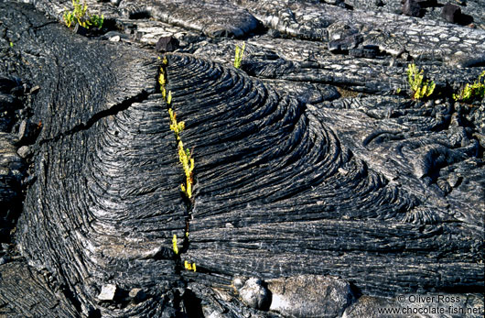
Landforms created by volcanoes
Volcanoes change the Earth by destroying everything in their path, but they leave rich, fertile soil behind that is great for farming.
Magma can come out of the volcano and spill into the ocean.
When it cools it forms an island
When lava spills over the walls of the volcano it cools and forms rocks. This is also changing the Earth.

Slide 8
Earthquakes
Earthquake Video

Slide 9
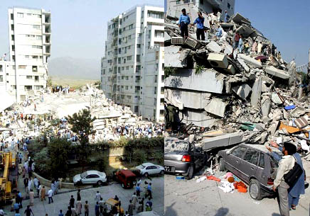
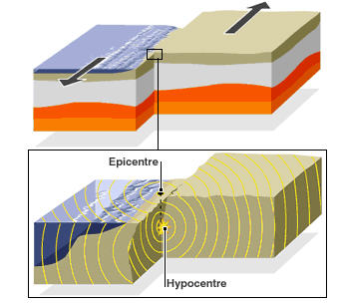
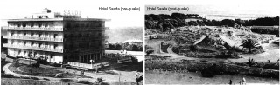
Earthquakes
Earthquakes can cause great devastation
An earthquake is what happens when two blocks of the earth suddenly slip past one another.

Slide 10
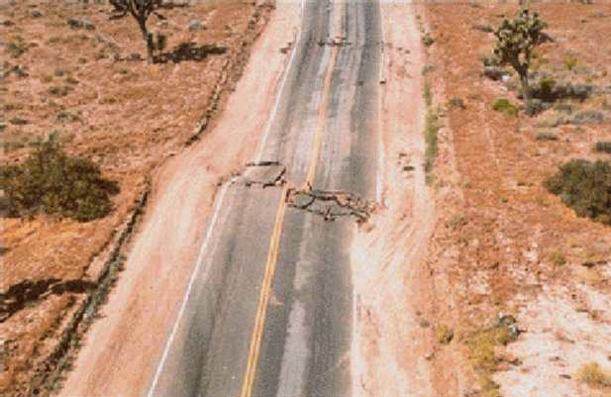
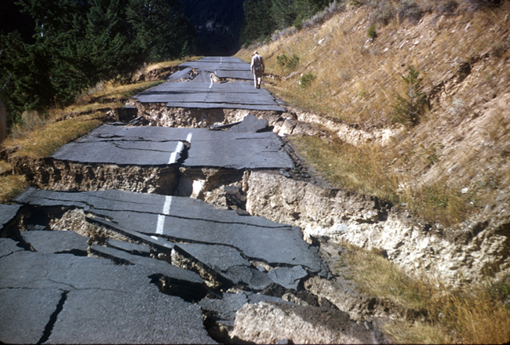
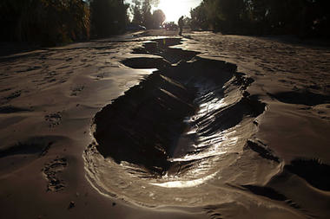
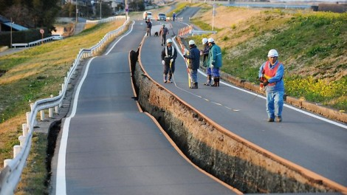
Changes to Earth surface caused by Earthquakes
Are these changes in the Earth’s surface?

Slide 11
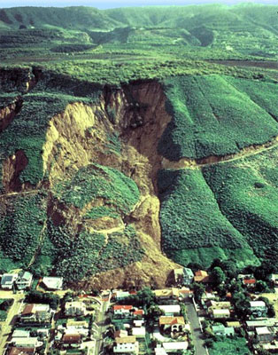
Landslides
Landslides take place when dirt, pebbles, rocks and boulders slide down a slope together.
Sometimes these landslides are small.
Other times they can be huge and they involve the entire side of a mountain.

Slide 12
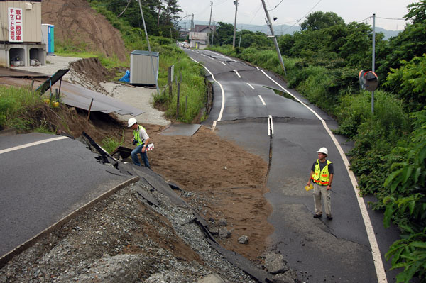
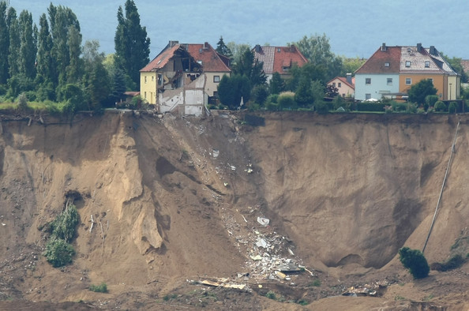
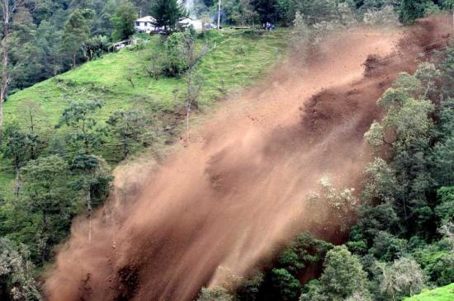
Are these slow or fast changes to Earth?
They are all fast changes caused by landslides.

Slide 13
Landslides
Landslides

Slide 14
Pompeii Pictures
These are all pictures that I took when I went to Pompeii, Italy. They are of the remains found in Pompeii after Mt. Vesuvius erupted and destroyed the entire city.

Slide 15
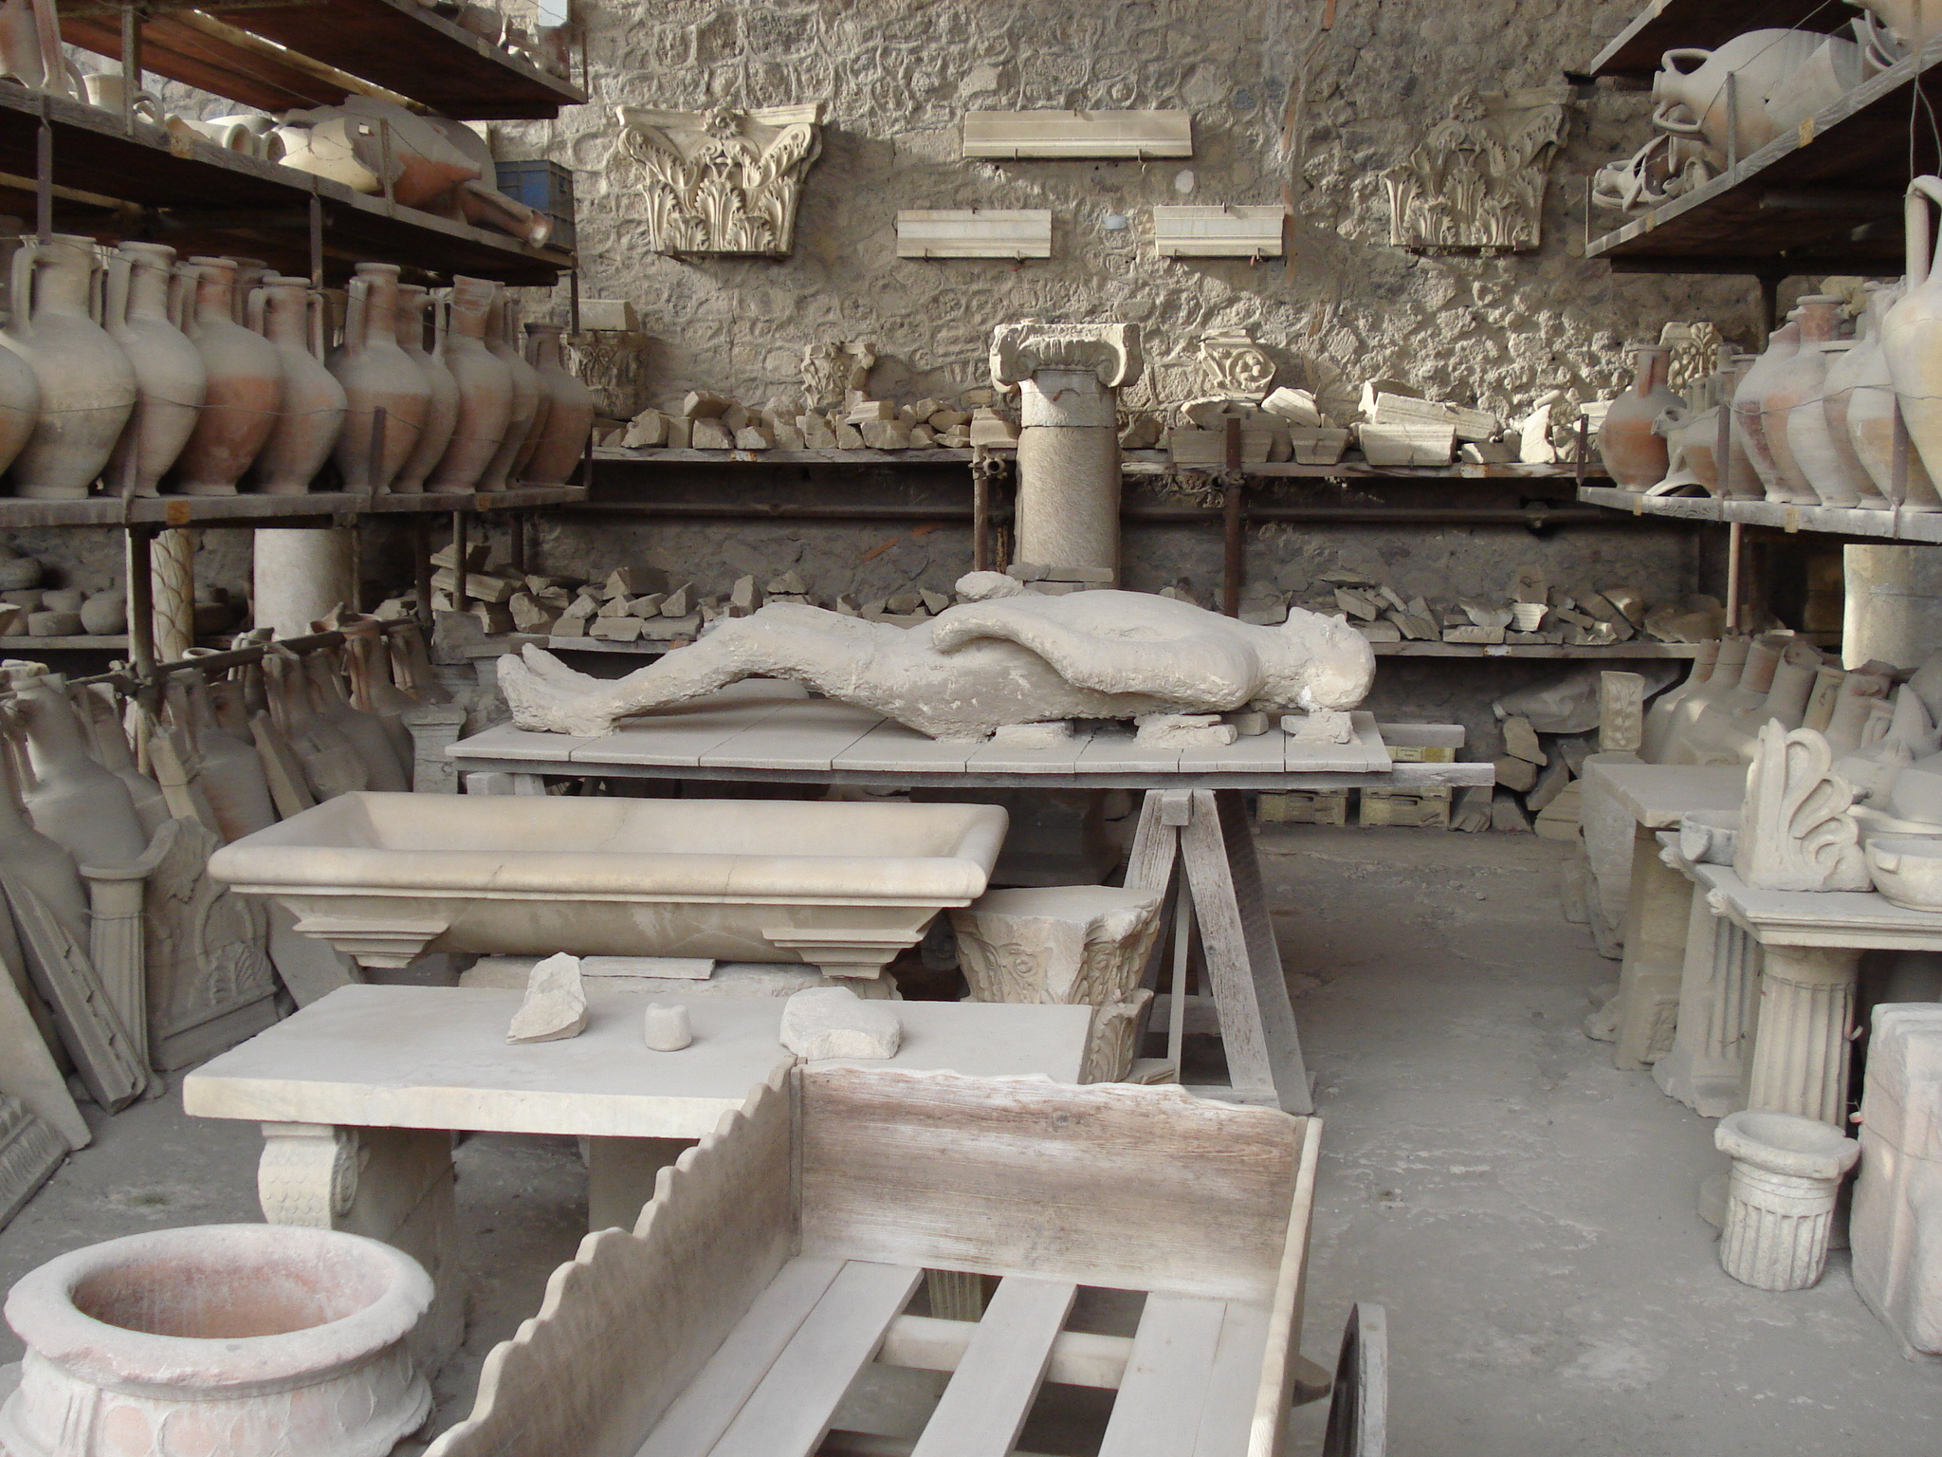

Slide 16
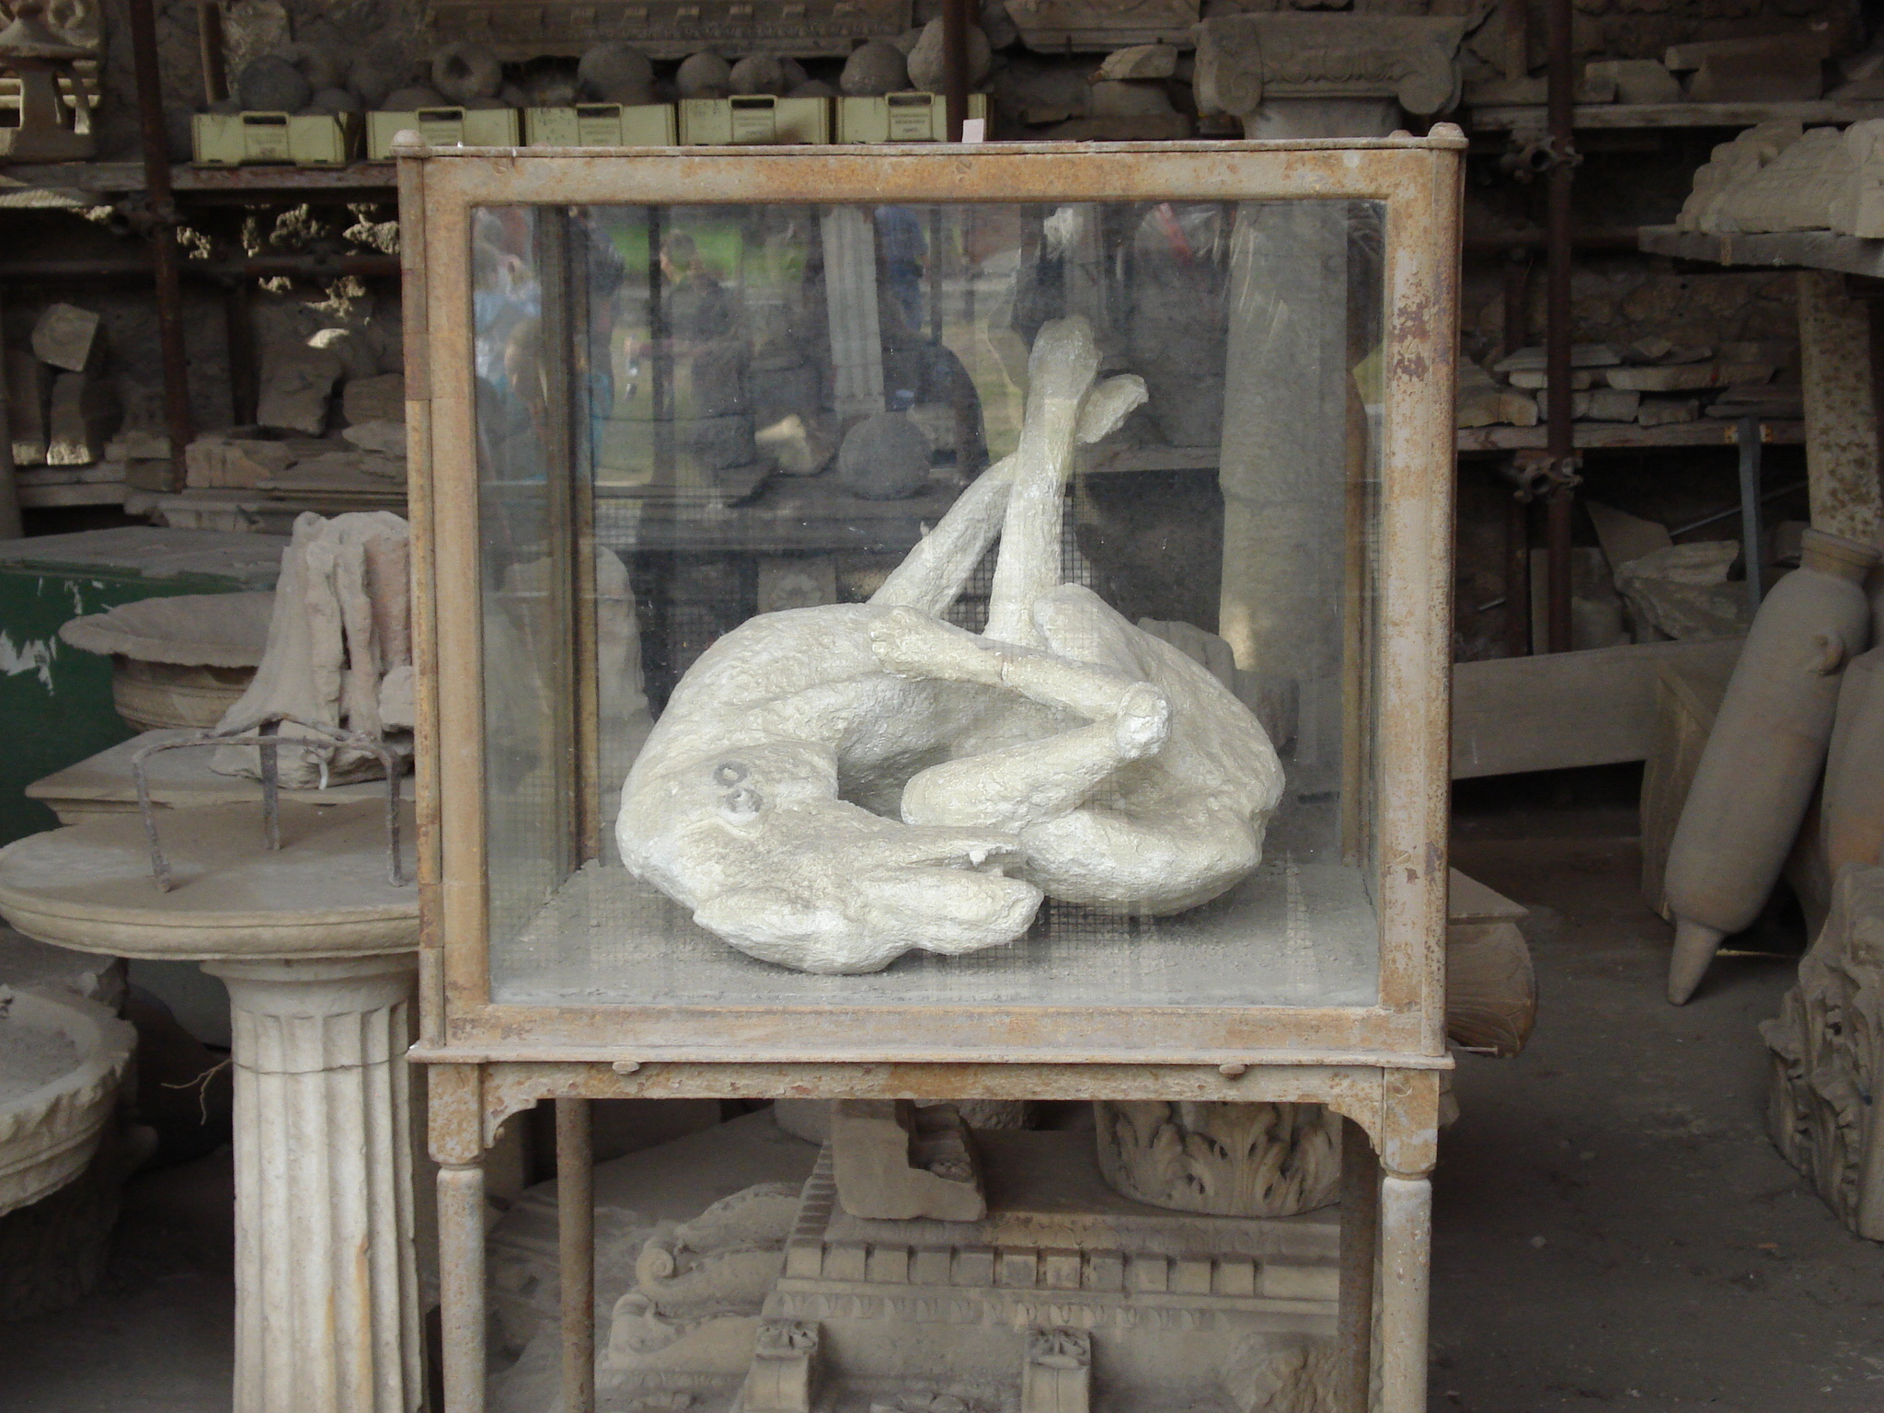

Slide 17
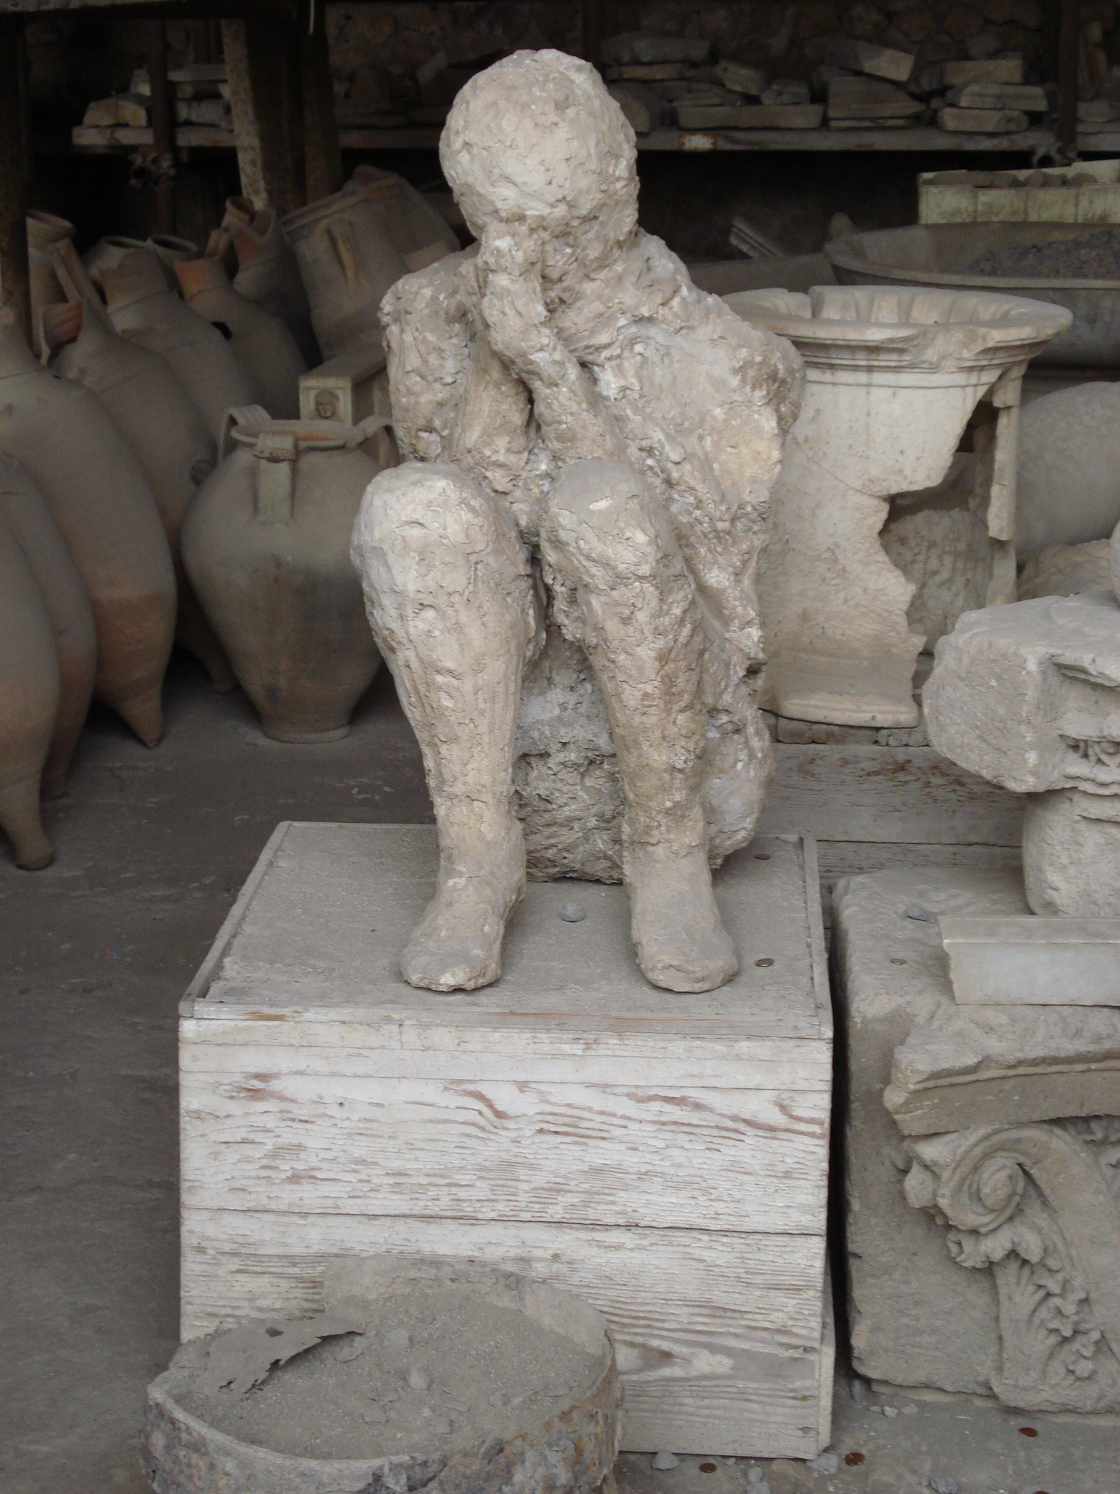

Slide 18
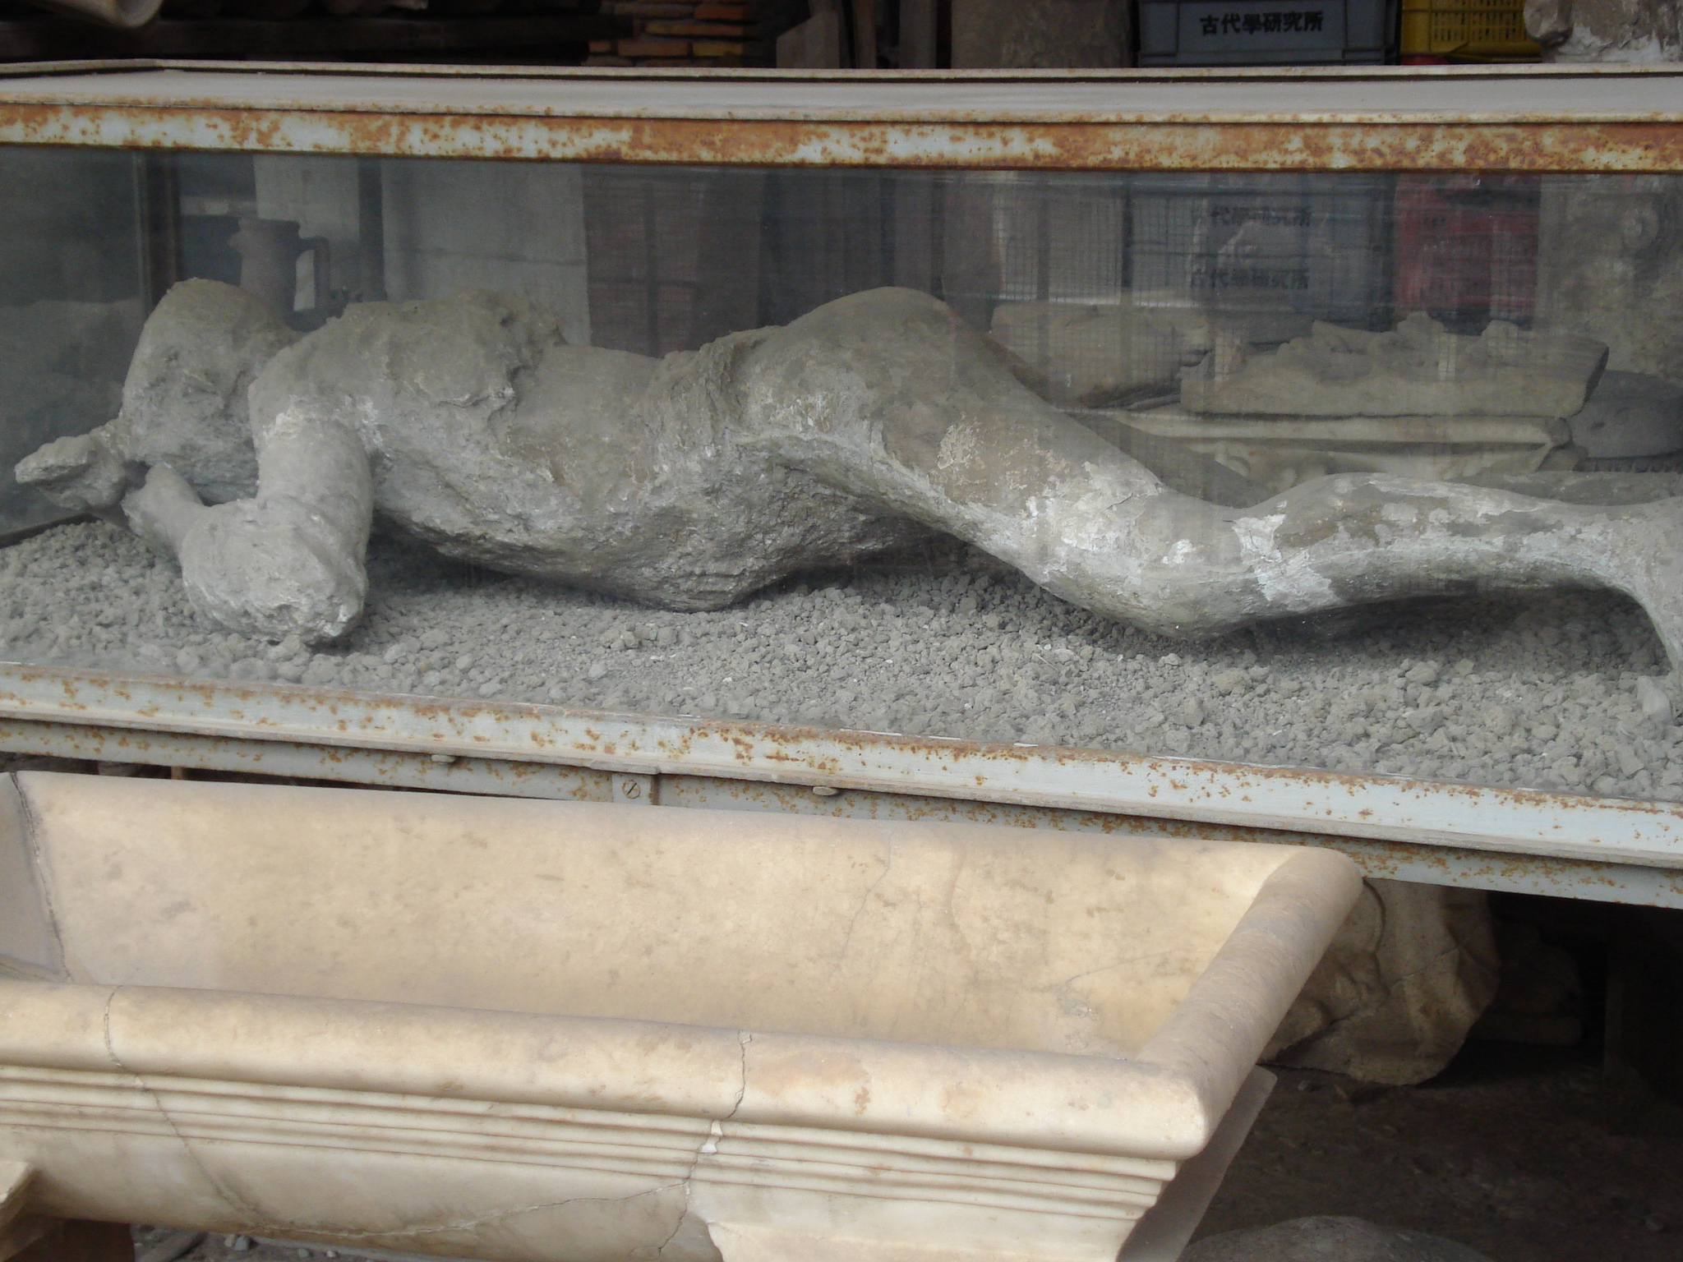

Slide 19
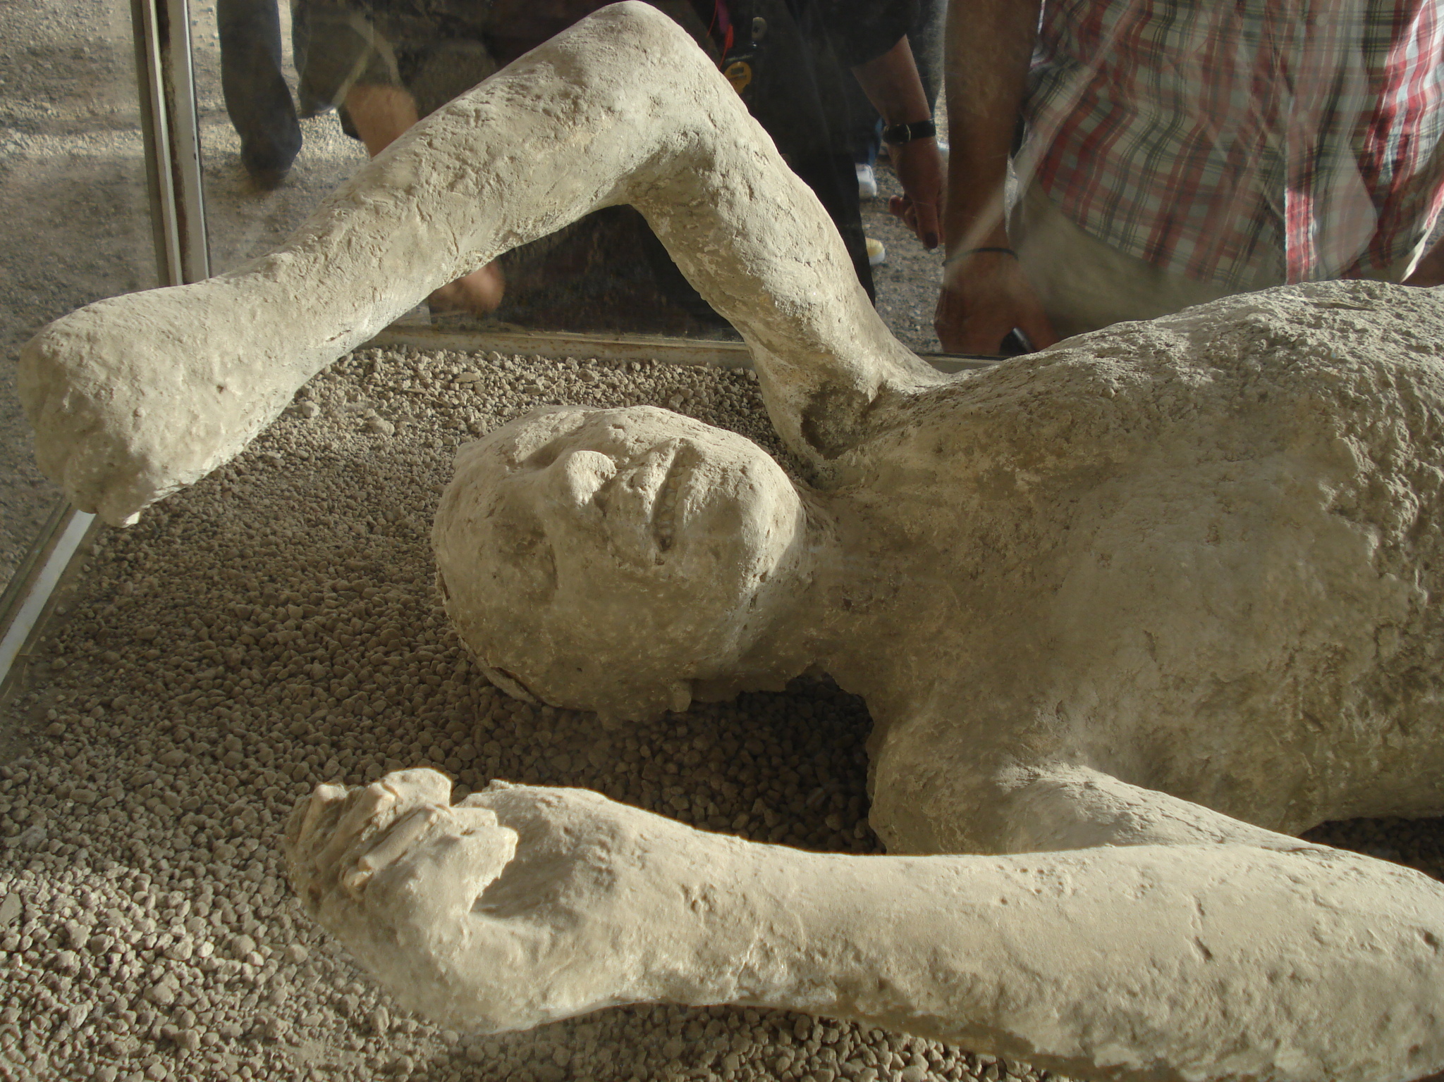

Slide 20
Changes in Earth Diagram
Causes of Change in Earth’s Surface
Volcanoes
(Force that caused change)
(Force that caused change)
New rocks, fertile land, islands
Rapid Process
(Examples of change)
(Examples of change)
(Examples of change)
(Examples of change)
(Is is gradual or rapid process?)
(Force that caused change)
(Is is gradual or rapid process?)
(Force that caused change)
(Is is gradual or rapid process?)
(Force that caused change)
(Is is gradual or rapid process?)
(Examples of change)
(Is is gradual or rapid process?)

